Slide 1
Week 11

Slide 2
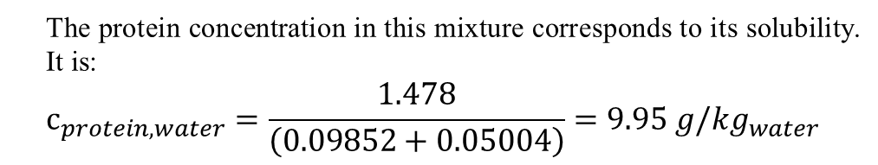
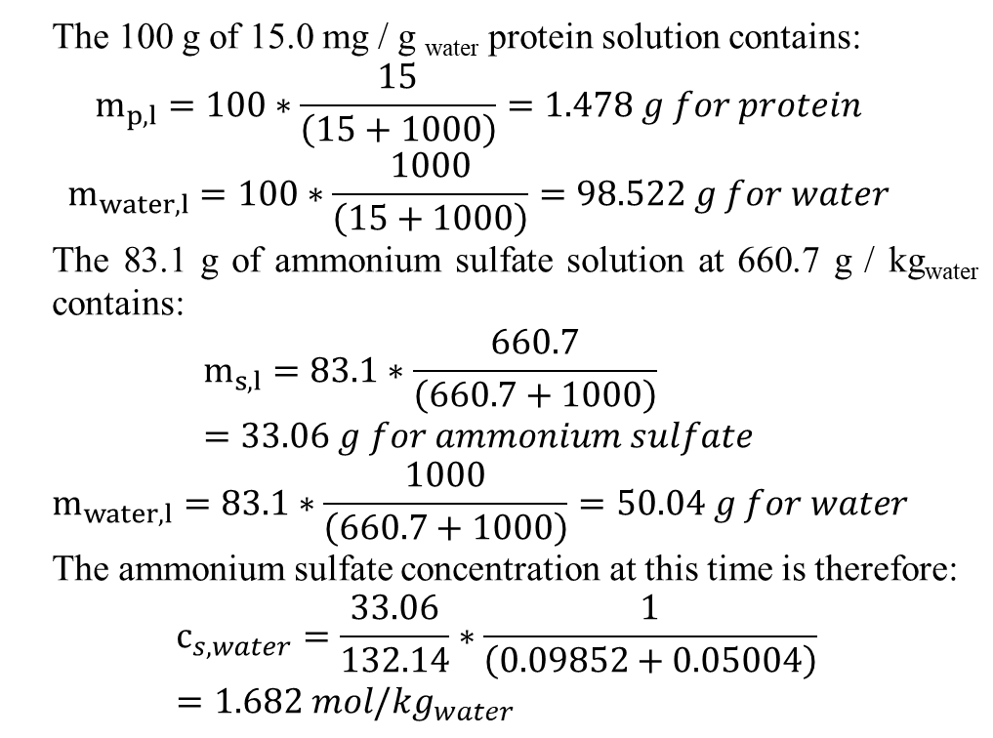
Exercise 3.1 – Salting-out with ammonium sulphate
A 660.7 g/kg_{water} solution of ammonium sulphate is added dropwise to 100 g of a 15.0 mg/g_{water} protein solution. After 83.1 g of the electrolyte solution have been added, the mixture becomes turbid, indicating that the protein solubility limit has been reached and precipitation has started.
What is the salt concentration at this point?
2. What is the protein solubility under these conditions?
The 100 g of 15.0 mg / g _{water} protein solution contains:
$$m_{p,l}=100∗\frac{15}{\left(15+1000\right)}=1.478 g for protein$$
$$m_{water,l}=100∗\frac{1000}{\left(15+1000\right)}=98.522 g for water$$
The 83.1 g of ammonium sulfate solution at 660.7 g / kg_{water} contains:
$$m_{s,l}=83.1∗\frac{660.7}{\left(660.7+1000\right)}=33.06 g for ammonium sulfate$$
$$m_{water,l}=83.1∗\frac{1000}{\left(660.7+1000\right)}=50.04 g for water$$
The ammonium sulfate concentration at this time is therefore:
$$c_{s,water}=\frac{33.06}{132.14}∗\frac{1}{\left(0.09852+0.05004\right)}=1.682 {mol/kg}_{water}$$
The protein concentration in this mixture corresponds to its solubility. It is:
$$c_{protein,water}=\frac{1.478}{\left(0.09852+0.05004\right)}=9.95 {g/kg}_{water}$$

Slide 3
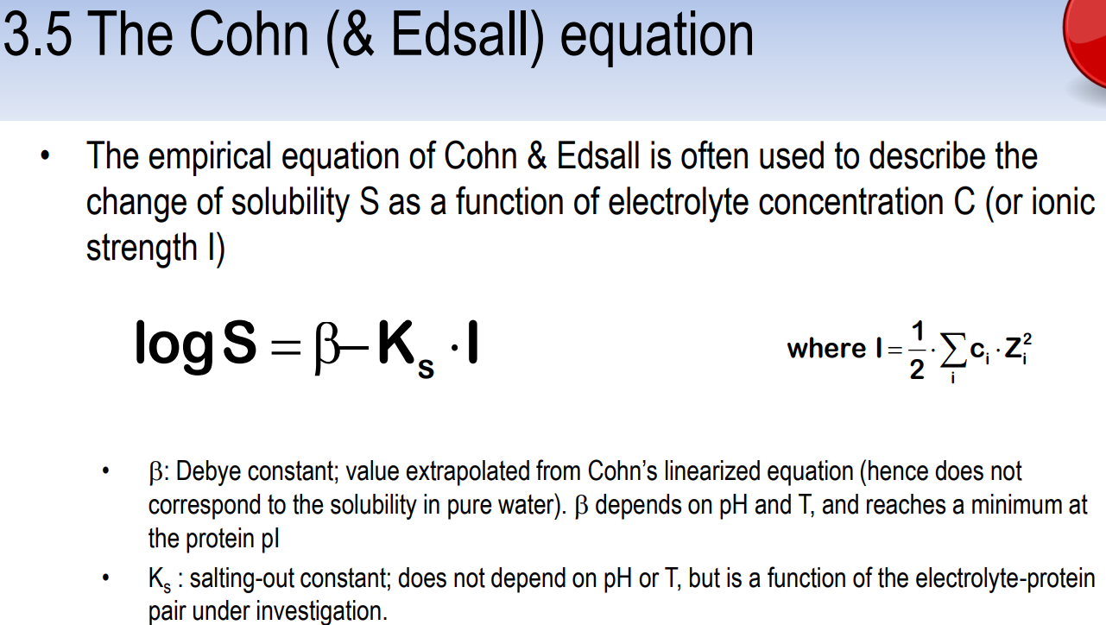
3. Use the data you have just calculated to complete the table below and determine the parameters of the Cohn equation (β and Ks). Please work with logS and ionic strengths.
NB: The molecular weight of ammonium sulphate is 132.14 g/mol.
The salt and protein concentrations are then added to the table and the data linearized according to the Cohn equation to yield the β and Ks coefficients
[(NH₄)₂SO₄] [mol/kg_{eau}] | S [g/kg_{eau}] | log10(s) | I
1.682 | 9.95 | 0.997823081 | 5.046
2.00 | 3.16 | 0.499687083 | 6
2.50 | 0.56 | -0.251811973 | 7.5
3.00 | 0.10 | -1 | 9
The result of the linear regression is shown below:
β=3.5346, Ks=0.5043

Slide 4
Exercise 3.2 – Edwin J. Cohn strikes again
A protein solution has an initial concentration of 15 g/l. After addition of ammonium sulphate up to 0.5 and 1.0 M, the residual protein concentrations in the supernatant after centrifugation were 13.5 and 5.0 g/l respectively.
• Based on this information, determine the coefficients of the Cohn equation
• Which (NH₄)₂SO₄ concentration will I have to reach in order to precipitate 95% of the protein?
IMPORTANT: In the absence of more detailed information, assume the Cohn equation is defined on a log10 basis with salt concentrations (and not ionic strength) in mole/l
[(NH₄)₂SO₄] [mol/L] | S [g/l] | log10(s)
0.5 | 13.5 | 1.130333768
1 | 5 | 0.698970004
1.955069823 | 0.75 | -0.124938737
β=1.5617, Ks=0.8627, on a log10 basis with salt concentrations (and not ionic strength) in mole/l.
1.95 M (NH₄)₂SO₄ concentration need to be reached in order to precipitate 95% of the protein

Slide 5
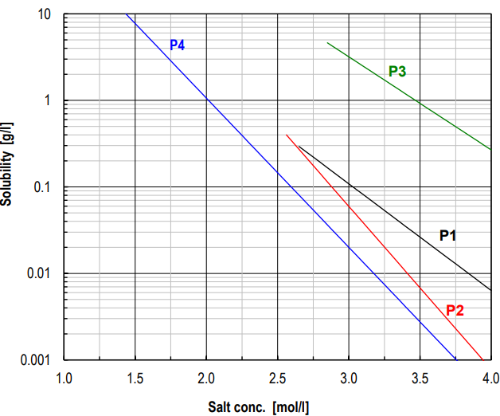
Exercice 3.3 – Fractional precipitation
Four different proteins are in a solution together, each with its own set of Cohn parameters (base ln, Ks defined relative to salt concentration and not to the ionic strength). The initial concentration of each protein is also given in the table below. Assuming all these parameters remain constant in the presence of other proteins:
1. Determine the highest possible recovery yield of protein 4 if it is to be collected at 100% purity
2. Which is the highest achievable recovery yield for protein 3 if it should represent at least 99% of the proteins present in the supernatant?
Protein | β | K_{s} [M⁻¹] | S₀ [g/l]
1 | 6.30 | 2.84 | 0.3
2 | 10.20 | 4.34 | 0.4
3 | 8.60 | 2.48 | 5.0
4 | 8.00 | 3.97 | 10.0
The graph below integrates all the data contained in the table

Slide 6
1. Determine the highest possible recovery yield of protein 4 if it is to be collected at 100% purity
In this case the graph clearly shows that it is protein 4 which will precipitate first, followed by protein 2 from 2.56 mol/l, protein 1 from 2.65 mol/l then protein 3 from 2.85 mol/l ammonium sulphate.
this means that between 0 and 2.56 mol/l of salt, only protein 4 is precipitated. Its residual concentration when protein 2 begins to precipitate is:
This means that between 0 and 2.56 mol/l of salt, only protein 4 is precipitated. Its residual concentration when protein 2 begins to precipitate is:
ln(S₄) = 8.00-3.97*2.56 = -2.163, hence S₄ = 0.115 g/l
Starting from 10 g/l and assuming that the addition of salt does not change the volumes, this means we have precipitated (10 - 0.115)/10 = 0.989 = 98.9% of protein 4 between 0 and 2.56 mol/l of salt.
Protein | β | K_{s} [M⁻¹] | S₀ [g/l] | ln(s) | salt conc. when S0
1 | 6.3 | 2.84 | 0.3 | -1.20397 | 2.642244
2 | 10.2 | 4.34 | 0.4 | -0.91629 | 2.561357
3 | 8.6 | 2.48 | 5 | 1.609438 | 2.818775
4 | 8 | 3.97 | 10 | 2.302585 | 1.435117

Slide 7
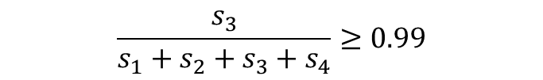
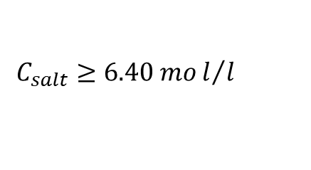
2. Which is the highest achievable recovery yield for protein 3 if it should represent at least 99% of the proteins present in the supernatant?
Protein 3 is the last to precipitate and that its concentration in the supernatant remains much higher than those of the others as the salt content increases, so that one would expect it to represent a large majority (99%) of the proteins still present in solution.
$$\frac{s_{3}}{s_{1}+s_{2}+s_{3}+s_{4}}≥0.99$$
$$C_{salt}≥6.40 mol/l$$
At 6.40 mol/l of precipitating agent, the residual concentration of protein 3 in the supernatant is of the order of 7*10⁻⁴ g/l, which represents only 1.4*10⁻² % of the initial quantity. This approach to recovering a relatively pure protein 3 is hence of no interest.

Slide 8
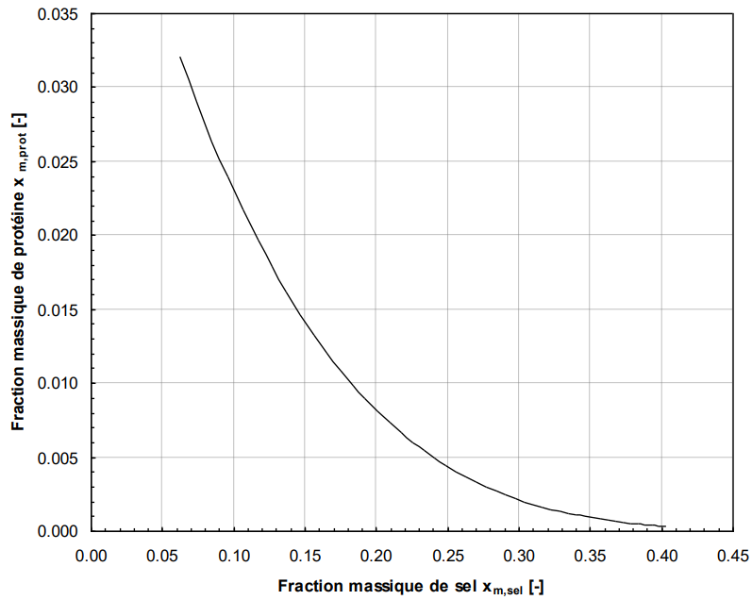
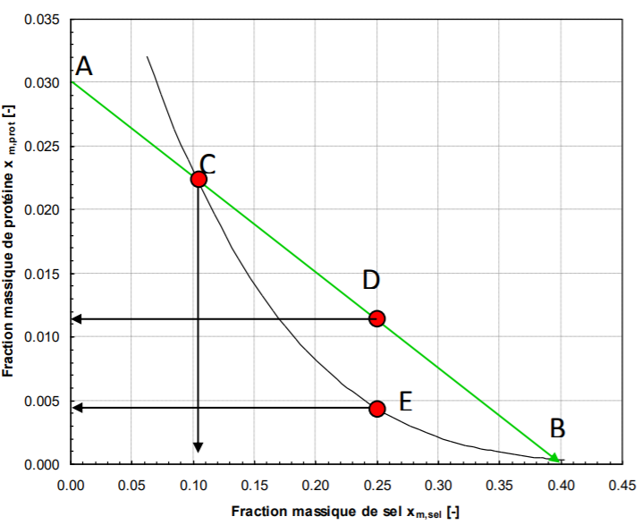
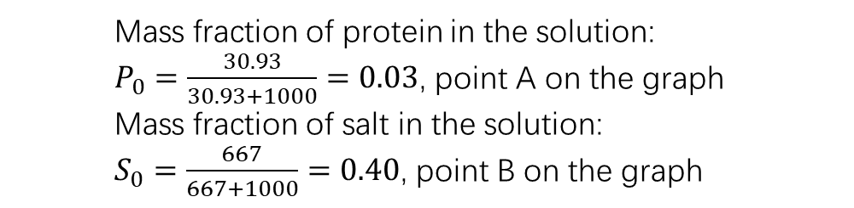
Exercice 3.4 – Protein precipitation: working with solubility curves
The solubility of a protein in the presence of ammonium sulphate has been measured and a curve drawn. It is shown in the Appendix to this exercise. We have 25 g of a 30.93 mg/g_{water} solution of protein, to which a 667 g/kg_{water} solution of ammonium sulphate is added dropwise.
Which quantity of salt solution will have to be added before a precipitation occurs?
How much salt solution will I have to add to the original protein solution to reach a 25% mass fraction of salt in the mixture?
What would the solubility of the protein be at this point?
What would the precipitation yield be?
Mass fraction of protein in the solution:
$P_{0}=\frac{30.93}{30.93+1000}=0.03$, point A on the graph
Mass fraction of salt in the solution:
$S_{0}=\frac{667}{667+1000}=0.40$, point B on the graph

Slide 9
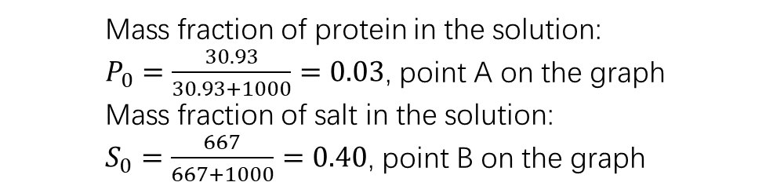
Which quantity of salt solution will have to be added before a precipitation occurs?
Mass fraction of protein in the solution:
$P_{0}=\frac{30.93}{30.93+1000}=0.03$, point A on the graph
Mass fraction of salt in the solution:
$S_{0}=\frac{667}{667+1000}=0.40$, point B on the graph
When adding the 40% salt solution to the 3% protein solution, we move along the straight line connecting points A (0.0 ; 0.003) and B (0.40 ; 0.0)
Point C: the mixture will become turbid and precipitation will occur. This happens at a salt mass fraction of ca. 0.105.
MAmSul = 8.90 g

Slide 10
2. How much salt solution will I have to add to the original protein solution to reach a 25% mass fraction of salt in the mixture?
To obtain a 25% mass fraction of salt in the mixture one has to keep adding salt solution until point D is reached
The total amount of salt solution that has to be added to the 25 g of protein solution is 41.67 g.
3. What would the solubility of the protein be at this point?
The solubility of the protein at such a salt concentration can be read from the graph at point E and is approximately 0.0043 [-]
4. What would the precipitation yield be?
The protein precipitation can be calculated as follows: the mixture at point D weighs a total of 25+42.1=66.67 g.
Its composition can be read from point D and allows the calculation of the amounts of protein (0.75 g), salt (16.68 g) and water (49.24).
However, only 67.1x0.0043 = 0.29 g of that protein is soluble. That means the rest (0.46 g) has been precipitated.
The precipitation yield is then 0.46/0.75 = 61%

